Slide 1
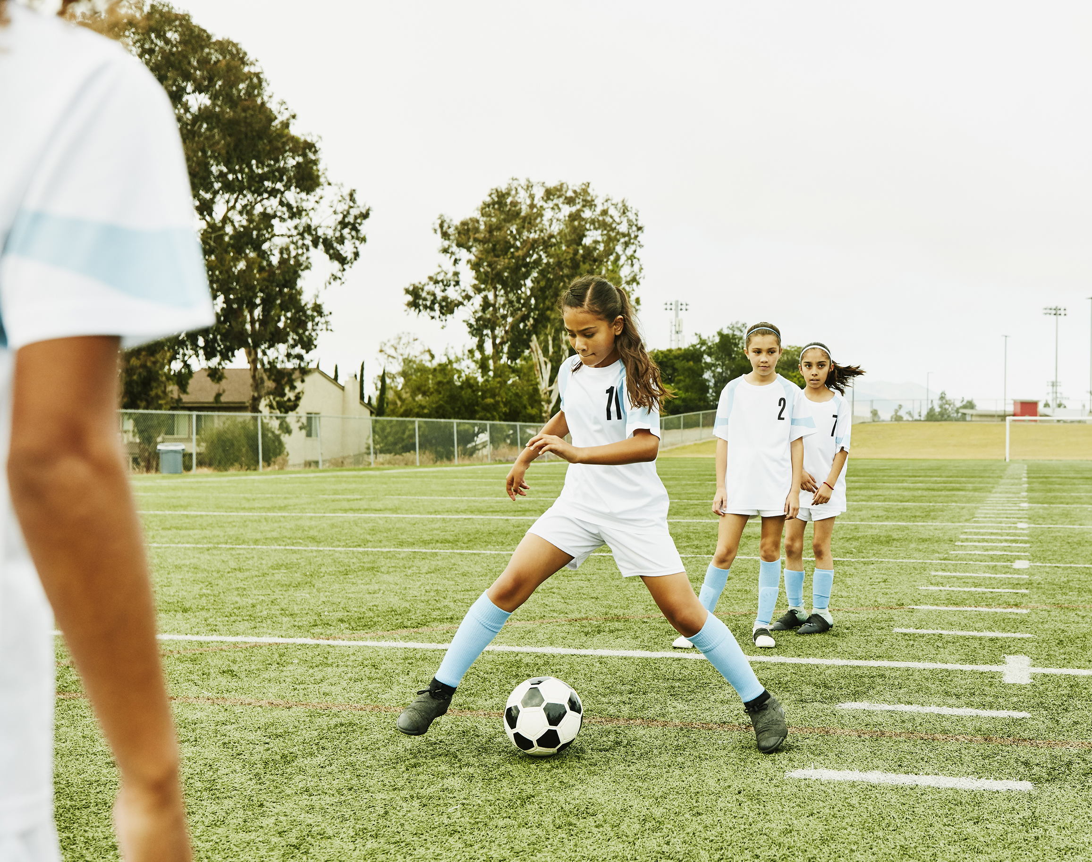
AGILITY
PHYSICAL EDUCATION

Slide 2
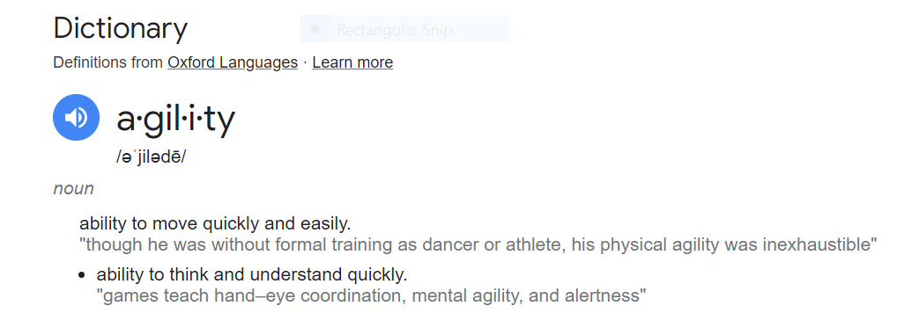
AGILITY:
DEFINITION:

Slide 3

A
L
L
E
N
I
V
E
R
S
O
N
A
L
L
E
N
I
V
E
R
S
O
N

Slide 4



COMPONENTS OF AGILITY
SPEED
How fast something moves or the rate at which it covers a certain distance in each amount of time. It's a measure of how quick or slow an object or person is traveling.
BALANCE
The ability to stay steady and not fall while you're standing, sitting, or moving. It's like keeping yourself upright and not tipping over.
COORDINATION
When your body parts work together smoothly and in harmony to perform tasks or movements. It's like all the pieces of a puzzle fitting together perfectly to achieve a specific action or goal.

Slide 5



COMPREHENSION CHECK
THE ABILITY TO CHANGE DIRECTION QUICKLY, MAINTAIN BALANCE, AND COORDINATE YOUR MOVEMENTS EFFECTIVELY.
A) CORE STRENGTH
B) AGILITY
C) CARDIOVASCULAR ENDURANCE
D) CIRCUIT TRAINING
E) SPRINTING
THE ABILITY TO STAY STEADY AND NOT FALL WHILE YOU'RE STANDING, SITTING, OR MOVING. IT'S LIKE KEEPING YOURSELF UPRIGHT AND NOT TIPPING OVER.
A) COORDINATION
B) AGILITY
C) SPEED
D) BALANCE

Slide 6
COMPREHENSION CHECK
HOW FAST SOMETHING MOVES OR THE RATE AT WHICH IT COVERS A CERTAIN DISTANCE IN A GIVEN AMOUNT OF TIME. IT'S A MEASURE OF HOW QUICK OR SLOW AN OBJECT OR PERSON IS TRAVELING.
A) COORDINATION
B) AGILITY
C) SPEED
D) BALANCE
WHEN YOUR BODY PARTS WORK TOGETHER SMOOTHLY AND IN HARMONY TO PERFORM TASKS OR MOVEMENTS. IT'S LIKE ALL THE PIECES OF A PUZZLE FITTING TOGETHER PERFECTLY TO ACHIEVE A SPECIFIC ACTION OR GOAL.
A) COORDINATION
B) AGILITY
C) SPEED
D) BALANCE

Slide 7

AGILITY EXAMPLE

Slide 8
SPEED
AGILITY
VS.
QUICK CHANGES IN DIRECTION
MAINTAINING BALANCE DURING RAPID MOVEMENTS
EFFECTIVE COORDINATION OF BODY MOVEMENTS
EXAMPLES: NAVIGATING AN OBSTACLE COURSE
MAKING SHARP CUTS IN SPORTS LIKE SOCCER OR BASKETBALL
HOW FAST YOU CAN RUN, CYCLE, OR MOVE FROM ONE POINT TO ANOTHER
MEASURED IN UNITS LIKE METERS PER SECOND (M/S) OR KILOMETERS PER HOUR (KM/H)
EXAMPLES: SPRINTING IN A RACE
RIDING A BIKE AS FAST AS POSSIBLE

Slide 9
COMPREHENSION CHECK
________________ INVOLVES QUICK CHANGES IN DIRECTION AND MAINTAINING BALANCE DURING MOVEMENT.
A) SPEED
B) AGILITY
________________ FOCUSES ON HOW FAST YOU CAN MOVE IN A STRAIGHT LINE OVER A DISTANCE.
A) SPEED
B) AGILITY

Slide 10
COMPREHENSION CHECK
________________ FOCUSES ON HOW FAST YOU CAN MOVE IN A STRAIGHT LINE OVER A DISTANCE.
A) SPEED
B) AGILITY
________________ OFTEN REQUIRES A COMBINATION OF PHYSICAL AND MENTAL SKILLS.
A) SPEED
B) AGILITY

Slide 11
AGILITY EXERCISES
Ladder Drills: Set up an agility ladder on the ground and perform various footwork patterns through the rungs. This can include high knees, lateral shuffles, and quick step-throughs.
Cone Drills: Arrange cones in different patterns and practice weaving in and out of them as quickly as possible. You can create straight-line drills, T-drills, or zig-zag patterns.
Cone Hops: Jump laterally over a cone or a line, landing softly and immediately jumping back to the other side.
Dot Drills: Draw or tape dots in a grid on the ground and hop or step quickly from one dot to another in various patterns.
Box Jumps: Use a plyo box or a sturdy platform and jump onto it from a standing position, then step down and repeat. This exercise improves explosiveness and lower-body agility.
Agility Hurdles: Place low hurdles in a line and practice hopping over them with quick, coordinated movements.
Jump Rope: Skipping rope helps improve coordination, footwork, and quickness, which are essential for agility.

Slide 12

AGILITY VISUALS

Slide 13
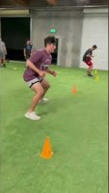
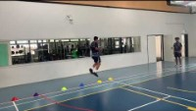
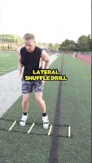
LADDER DRILLS
CONE DRILLS
CONE HOP

Slide 14


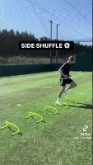
DOT DRILLS
BOX JUMPS
AGILITY HURDLES

Slide 15


Slide 16
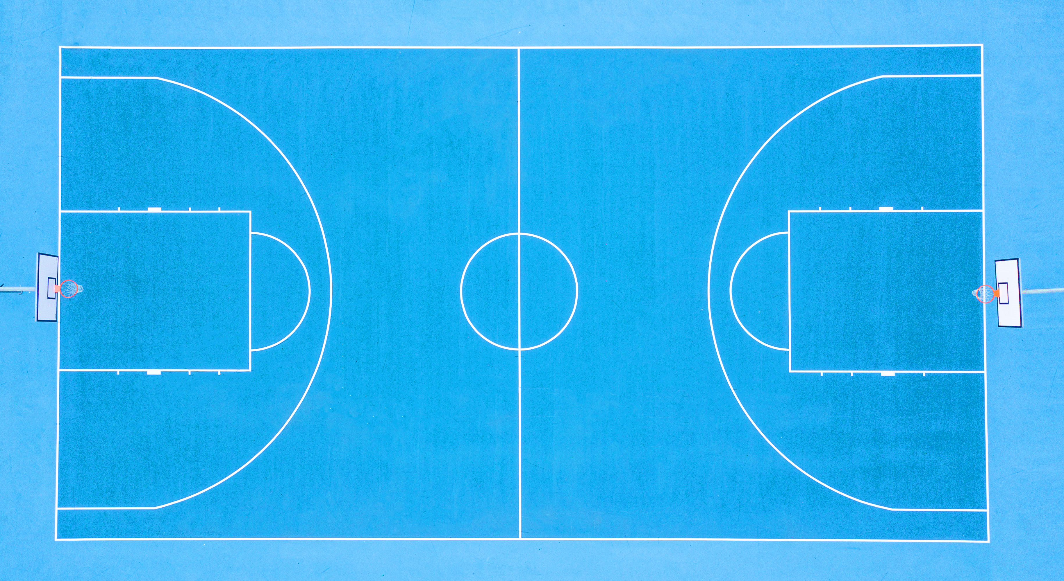


AGILITY OBSTACLE COURSE
WEAVE THRU⁸↓
AGILITY HURDLES⁷↓
SLIDE⁹→
SPRINT¹²→
AGILITY HURDLES⁶↓
SPRINT¹¹¹→
SPRINT¹⁰→
SPRINT⁴→
SPRINT⁵→
AGILITY HURDLES⁶↓
FINISH→
START
←SLIDE³
AGILITY LADDER¹↑
SPRINT²→

